Slide 1

Sustainable
Solid Waste Management in Rural Construction
Environmentally Sustainable
Cold Regions Construction Practices
October 31, 2016
Presented by ADEC Solid Waste Program
Notes:
Introductions

Slide 2
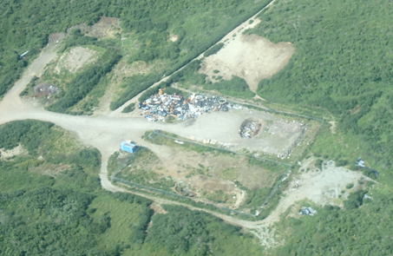
Issues with C & D Debris Disposal in Rural Alaska
Generally large quantity
of waste
Waste is bulky and
harder to compact
Takes up valuable space
in a landfill
½ acre
Notes:
Space is money. It can be very expensive to build a new landfill so it might not be economical to use up a lot of space even with heavy tipping fees.
Give examples of C&D and what is not C&D
2 to 4 million to build a new landfill. Takes about 5 years for funding and additional time to build landfill after funding is received.

Slide 3
Issues with C & D Debris Disposal in Rural Alaska
No permitted landfill or landfill won’t accept waste
Backhaul options may be limited
Overlooking disposal costs in project bid (don’t assume disposal is free)
Generator of the waste is responsible for legal disposal
Notes:
Limited heavy equipment for compaction
Metals backhauls are less frequent with low prices
barges

Slide 4
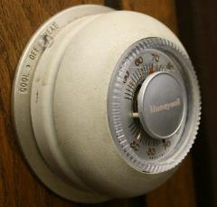
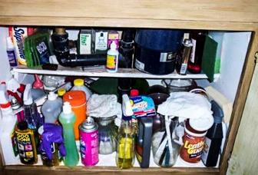
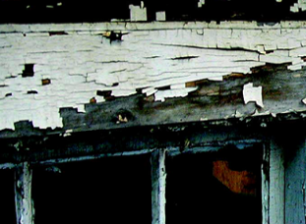
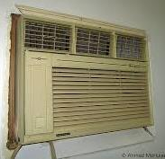
Contractor Responsibilities
Identify all potentially hazardous materials prior to demolition and have them tested and properly disposed
  Asbestos
  Chipping/flaking lead-based paint
  Mercury switches, bulbs, thermostats & electronics
  CFCs from appliances and aerosol cans
  Radioactive smoke detectors or exit signs
  PCBs in transformers, lubricants, paints, and sealants
  Potentially toxic chemicals, cleaners, pesticides
Notes:
As a commercial entity, you must follow the RCRA requirements for determining your generator status and requirements for disposal.
NO COMMERCIAL or INSTITUTIONAL HAZARDOUS WASTE MAY BE DISPOSED IN A CLASS III LANDFILL

Slide 5

Contractor Responsibilities
Know your disposal options
  Community Landfill
  Private Landfill
  Ship all waste out
  ACM and CESQG waste CANNOT be disposed in a Class III Landfill – must be shipped out
Contact ADEC to ensure proper
landfill permits
Work with the local community for mutual benefit
Notes:
Some Private C&D Monofills in the State – most are on the road system
Shipping Waste out is costly……However, You must remove and ship out ALL asbestos (even non-friable) & Hazardous waste
Make sure a landfill has a CURRENT Permit – call to confirm
Talk about Contractor Letter and enforcement campaign for illegal disposal.
Work with the community

Slide 6
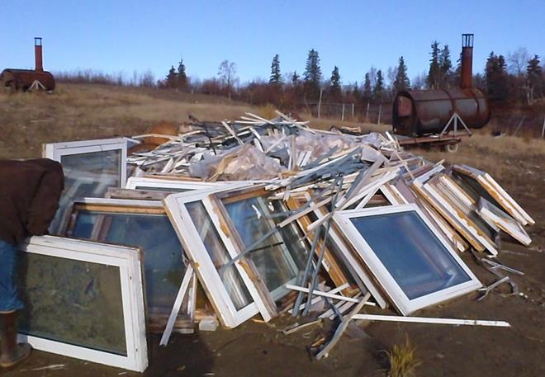
Contractor Responsibilities
For Sustainability, consider:
Careful design and ordering to reduce waste
Reuse & Recycling options
For Demolition
  Deconstruction to preserve
  more reusable materials
  Stockpiling for community
  reuse

Slide 7
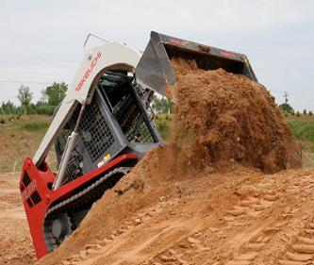
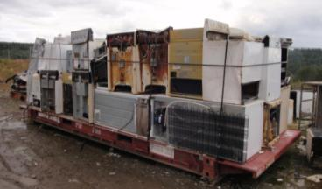
Community Coordination
Early communication is essential
Don’t assume waste will be accepted at the local landfill
Determine what restrictions exist
  Permit Restrictions (e.g. No ACM)
  Local Ordinances
Determine options
  Fees/In-Kind Services
  Reuse within the community
  Backhaul/Recycle
Notes:
Expect in kind services but can’t require

Slide 8
C&D Waste Disposal Options
Disposal is allowed ONLY in a permitted landfill
Options for disposal include:
  Class I MSWLF
  Class II MSWLF
  Class III MSWLF
  Inert Waste monofill
  Asbestos monofill
  One-Time monofill
  Exempt waste
Use of Class I and Class II MSWLFs requires backhaul of waste
Notes:
Municipal landfills and existing monofills MAY accept your waste but are not required to.
Many municipal landfills only accept waste from their area, or charge a premium for outside waste.
A useful option for some contractors has been the one-time asbestos or C&D monofill, which we will discuss in detail in a few slides.

Slide 9
C & D Waste Disposal in a
Class III MSWLF
Not required to accept C&D
Can charge special rates for C&D
Cannot accept ANY ACM or CESQG waste
Small landfills easily overwhelmed by C&D debris, so offering in-kind services is helpful:
  Help with obtaining landfill permit
  Help with landfill cleanup & cover
  Shred or crush waste before it goes to the landfill
  Compact waste as it is placed in landfill
  Repair landfill access roads
Notes:
It is all about working UP FRONT with the community. If you wait until you are on the job, waste issues may hold up completing the project.
Ask about their needs at the landfill, and how you can help make improvements while you are there – you can also contact the ADEC site manager to discuss landfill issues, and they can provide assistance in working with the community.

Slide 10
One-Time Inert Waste Monofill
  Conditional Authorization:
  Location
  Remote area with no year-round ground access to a major road system.
  No reasonable access to an existing permitted landfill – or the landfill refused to accept the waste (proof)
Notes:
Generator is Responsible for Application, Operation, and Closure
Landowner consent is required so this needs to be addressed during the planning process. State Lands (additional permitting), tribal lands, city.
Contacting the community is important and starts with early planning. This may also provide opportunities for in kind services and agreements. Respectful to the community.
Authorizations will be issued under Alaska Statute (AS) 46.03.100(d).

Slide 11
One-Time Inert Waste Monofill
  Location
  Disposal Site must meet regulatory requirements (Slope, Unstable Soils, Wetlands, Flooding, Washout)
  Landowner Consent
Notes:
Landowner consent – We’ve got a form for that!

Slide 12
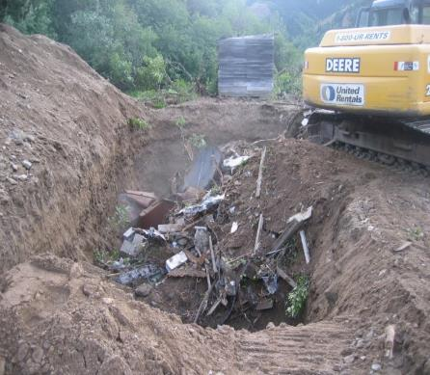
One-Time Inert Waste Monofill
  Waste
  Generated locally – not more than 25 miles
  Consist of building debris, non‑RACM, scrap metal, and other C&D waste
  Generated from a single project
  < 1,000 cubic yards.
  Duration
  May not exceed one year
Notes:
Generator is Responsible for Application, Operation, and Closure
Landowner consent is required so this needs to be addressed during the planning process. State Lands (additional permitting), tribal lands, city.
Contacting the community is important and starts with early planning. This may also provide opportunities for in kind services and agreements. Respectful to the community.
Authorizations will be issued under Alaska Statute (AS) 46.03.100(d).

Slide 13
One-Time Asbestos Monofill
Additional Requirements
<250 Cubic Yards
Daily Cover
Correctly Contained and Labeled
Complete/Accurate Shipment Records
Handling Policy (Prevent release of fibers)
Permanent Markers
Warning Signs
Public Access Restricted (Berms, Fences, Remote)
Notes:
Similar permitting to the one-time C&D – includes some other Asbestos specific conditions. Only necessary for friable asbestos (RACM). Non-RACM can be disposed in the C&D monofill if managed properly.

Slide 14
Inert Waste Monofill
May be needed or desired due to:
Multiple projects in one location or nearby locations
Outside the 25-mile range of
the One-Time authorization
Waste Quantity will exceed
1000 cubic yards
Multi-year project
Notes:
This option could be feasible if multiple construction and demolition projects are anticipated in a region that has access to the proposed monofill. Coordination with tribal/city councils, contractors, and ADEC may identify the need of an inert waste monofill in a certain area. It is possible to obtain an inert waste monofill permit but the other options are usually more feasible for the C & D Debris generated from rural projects.

Slide 15
Inert Waste Monofill
Requires public notice (for permit) &
Design Drawings
Operations Plan
Potential monitoring
Post-closure monitoring for minimum 5 years
On site inspections
Annual Fees
Financial Assurance
Contact ADEC!!!
Notes:
Much more complex permit and requires significant lead time for design, review, public notice, comment response, etc.

Slide 16
Exempt Waste
Does not require disposal in permitted landfill
Can be used as fill if the following requirements are met
  Cannot be mixed with non-exempt waste
  May not cause nuisance, environmental programs, or threaten public health and safety
  Cannot be placed in surface water
  Cannot be placed without landowner approval
Notes:
Some types of waste are exempt from SW regs and do not require disposal in permitted landfill
These wastes include:
Uncontaminated dirt, rocks, and soil;
Tree limbs, stumps, foliage, and other woody debris;
Unpainted bricks, mortar, Portland cement type concrete (including reinforcing steel that cannot be easily removed);
Glass crushed to less than ¾-inch minus;
Crushed asphalt, but only if the product is used:
As fill material for a building pad or parking area;
As road base beneath a parking area or road;
As pavement on a building pad, parking area, or road; or,
As a material to construct a containment berm for a tank farm
The person disposing of exempt solid waste must comply with the following requirements:
The exempt waste may not be mixed with non-exempt waste.
The waste may not cause a public nuisance, environmental problem, or a threat to public health, safety, or welfare.
The exempt waste may not be placed in surface water (creeks, ponds, etc.) without approval from other appropriate regulatory agencies.
The exempt waste may not be placed without landowner approval.
Note: Most construction and demolition debris including dimensional lumber, regardless of treatment, are NOT EXEMPT WASTES. These wastes must be disposed at a permitted facility.

Slide 17
Other Considerations
Include waste backhaul with equipment demobilization
Don’t leave excess materials unless usable and agreed to by the community
Remove or reuse ALL fluids
Wastes left behind become someone else’s problem, or your return trip
Demolition – consider “de-construction” to allow community to reuse materials

Slide 18
Questions?
ADEC Solid Waste Program
Reese Thieme
reese.thieme@alaska.gov
907-269-7590
Kaylie Holland
kaylie.holland@alaska.gov
907-269-7626
dec.alaska.gov/eh/sw
Notes:
Mention:
Guidance page – C&D, Asbestos, other disposal topics.
Rural Contacts
Letter to Contractors – Enforcing against contractors using unpermitted landfills.

Slide 19


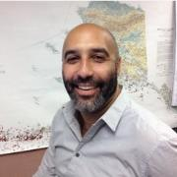
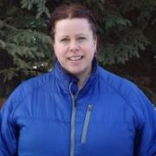
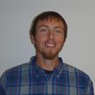
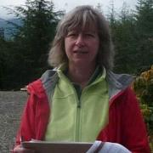

Rural
Landfills
ADEC
Solid Waste Program
Contacts
Other
Landfills
Trisha Bower
Northern & Interior
451-2174
Statewide
Kaylie Holland
Large Municipal Landfills
Southcentral/Western
269-7626
Southcentral/Western
Regional Manager
Lori Aldrich
269-7622
Stephen Price
Bristol Bay, Lake & Penn
Kodiak, Lower Yukon
269-7467
Northern/Interior/Southeast
Regional Manager
Doug Buteyn
451-2135
Sarah Durand
Interior/Upper Yukon
451-2761
Neil Lehner
Municipal/Industrial Landfills
Northern/Interior
451-2134
General Program Info
Rebecca Colvin
269-7802
?
Contact
269-7622
Water Monitoring &
Technical Assistance
Marty Brewer
269-1099
Sandi Woods
Southeast/NW Arctic
465-5318
VACANT
Kuskokwim/Aleutians East
269-7642
Reese Thieme
Oil and Gas Facilities
Statewide
269-7590

